Slide 1
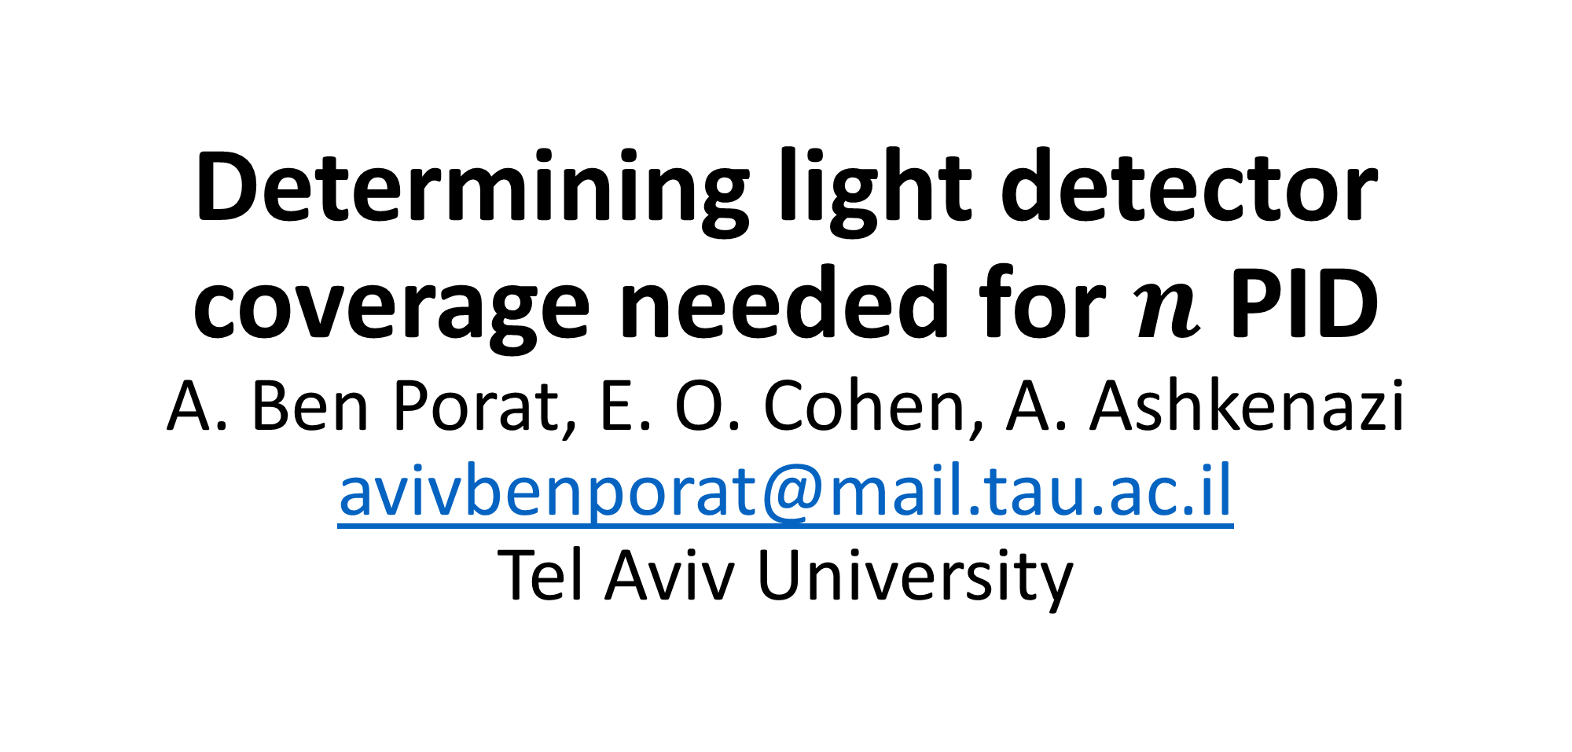
Determining light detector coverage needed for $n$ PID A. Ben Porat, E. O. Cohen, A. Ashkenazi avivbenporat@mail.tau.ac.il Tel Aviv University

Slide 2
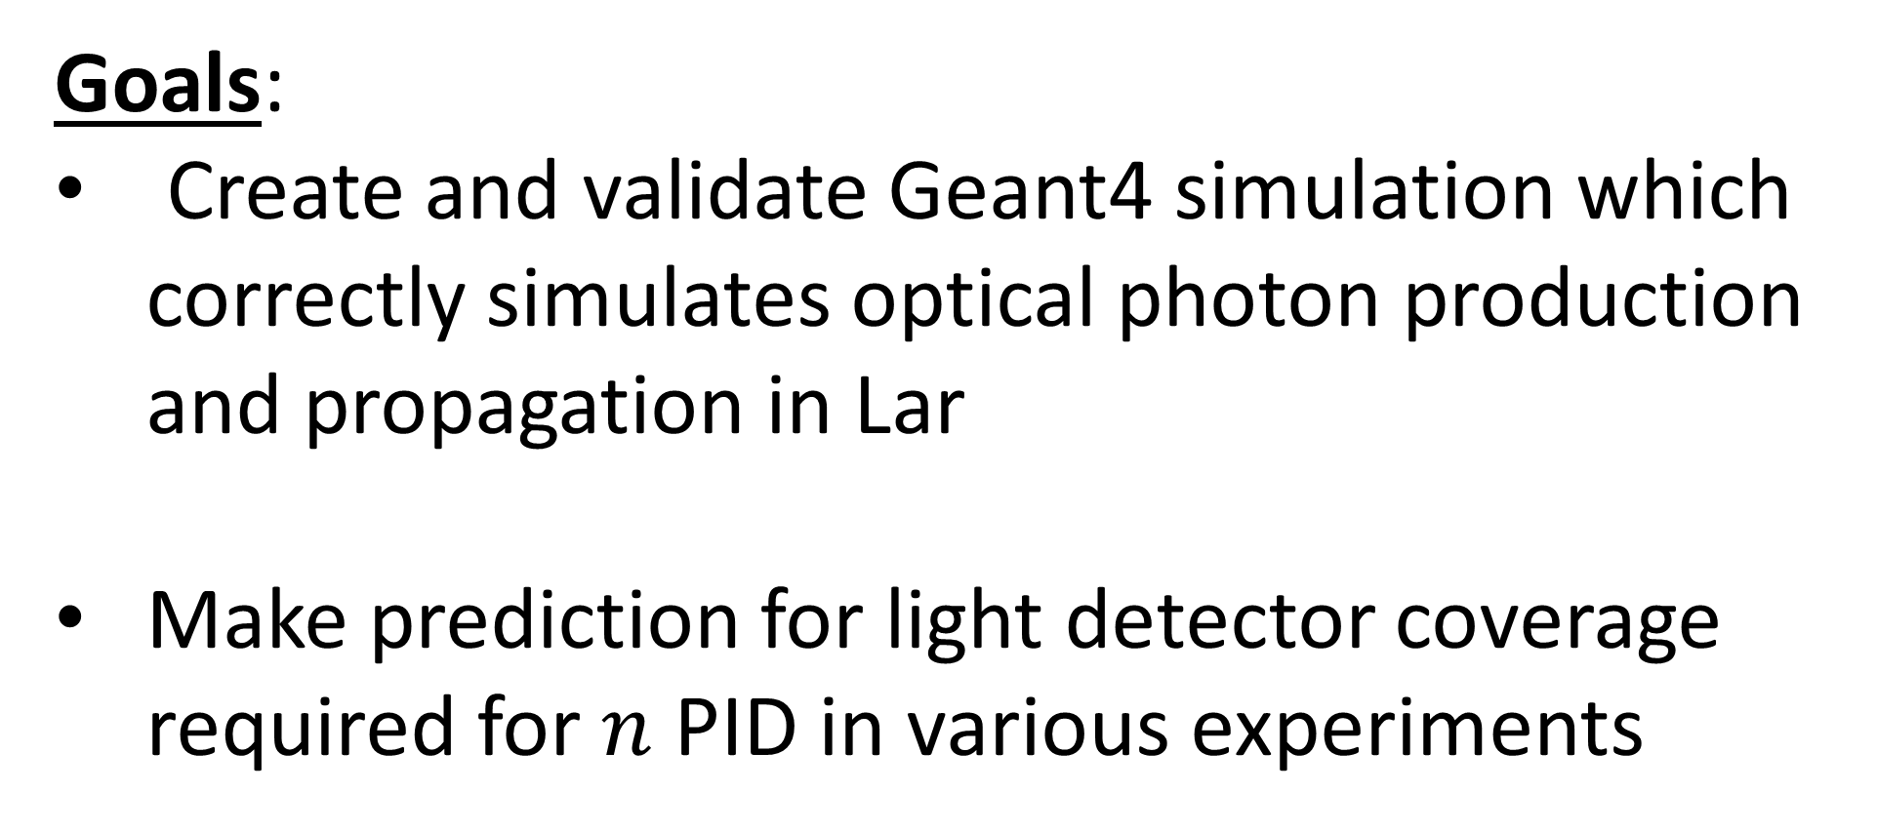
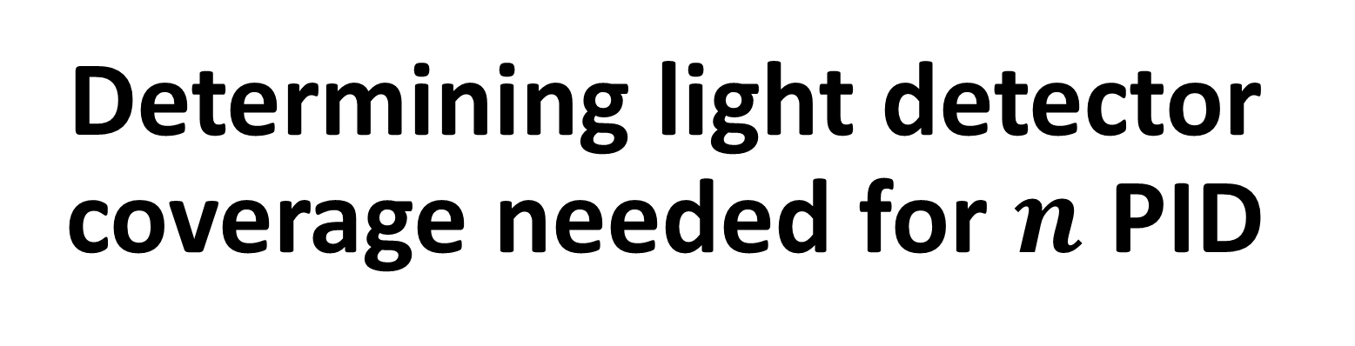
Determining light detector coverage needed for $n$ PID
Goals:
Create and validate Geant4 simulation which correctly simulates optical photon production and propagation in Lar
Make prediction for light detector coverage required for $n$ PID in various experiments

Slide 3
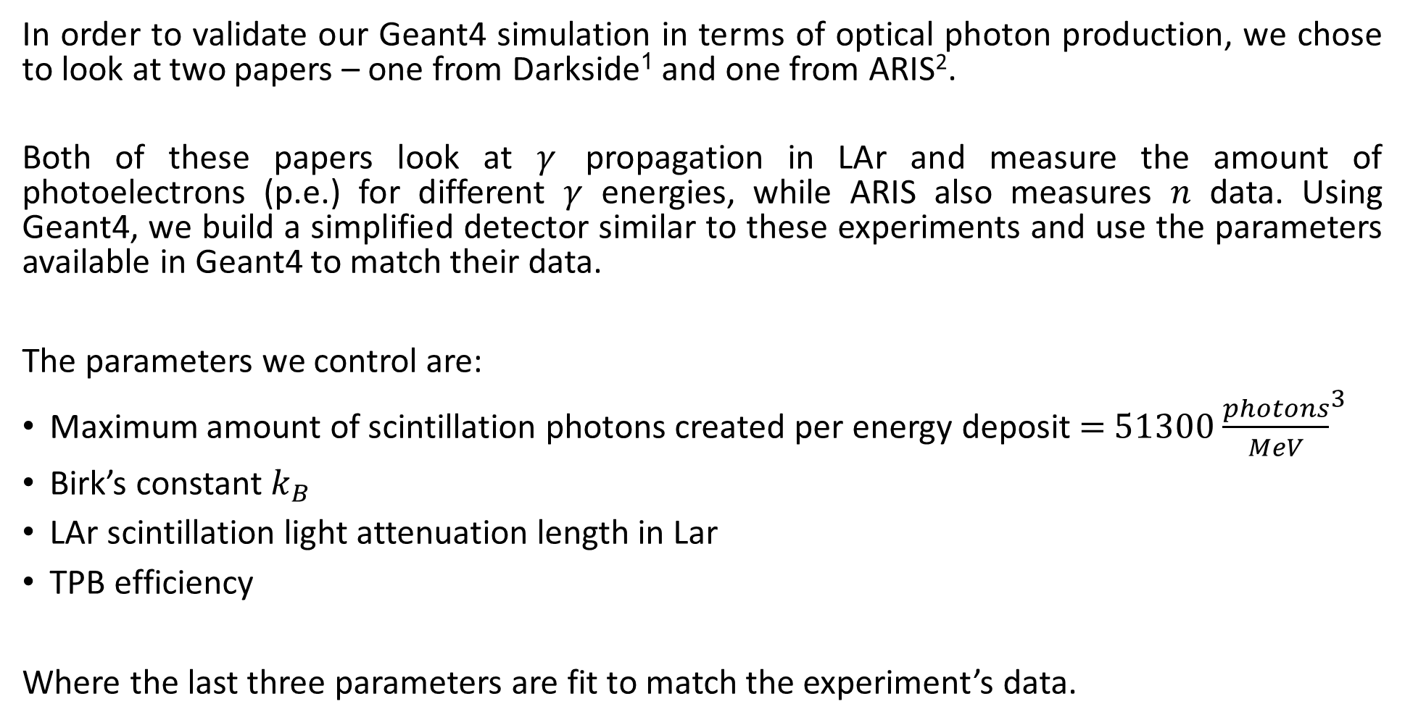
Optical photon validation
In order to validate our Geant4 simulation in terms of optical photon production, we chose to look at two papers – one from Darkside¹ and one from ARIS².
Both of these papers look at $γ$ propagation in LAr and measure the amount of photoelectrons (p.e.) for different $γ$ energies, while ARIS also measures $n$ data. Using Geant4, we build a simplified detector similar to these experiments and use the parameters available in Geant4 to match their data.
The parameters we control are:
Maximum amount of scintillation photons created per energy deposit $=$ $51300$ ${\frac{photons}{MeV}}^{3}$
Birk’s constant $k_{B}$
LAr scintillation light attenuation length in Lar
TPB efficiency
Where the last three parameters are fit to match the experiment’s data.

Slide 4
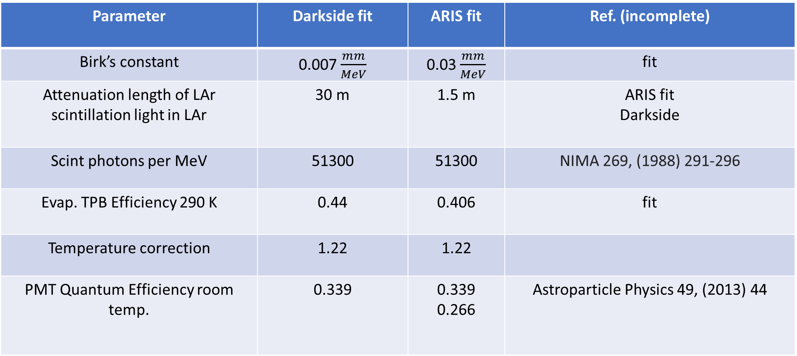
After some research we found the optimal parameters which are summarized in the following table:
Parameter | Darkside fit | ARIS fit | Ref. (incomplete)
Birk’s constant | 0.007 $\frac{mm}{MeV}$ | 0.03 $\frac{mm}{MeV}$ | fit
Attenuation length of LAr scintillation light in LAr | 30 m | 1.5 m | ARIS fit Darkside
Scint photons per MeV | 51300 | 51300 | NIMA 269, (1988) 291-296
Evap. TPB Efficiency 290 K | 0.44 | 0.406 | fit
Temperature correction | 1.22 | 1.22
PMT Quantum Efficiency room temp. | 0.339 | 0.339 0.266 | Astroparticle Physics 49, (2013) 44

Slide 5
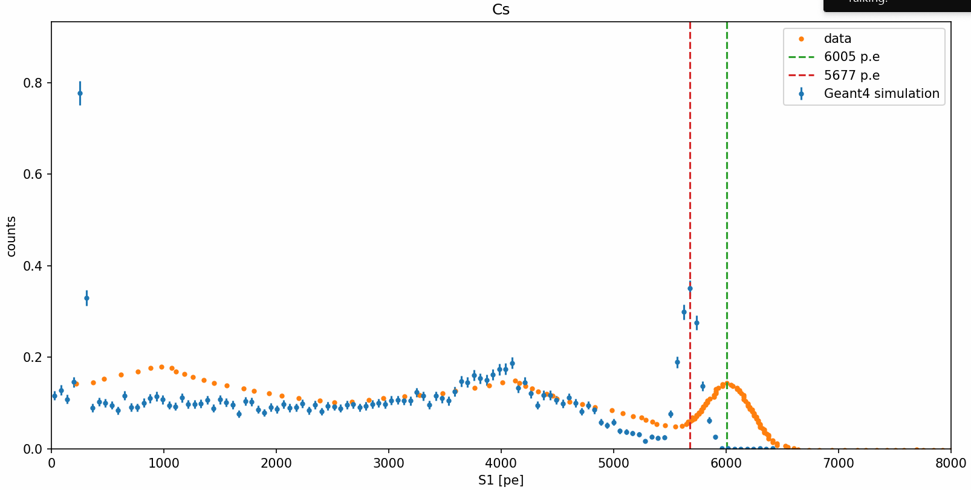
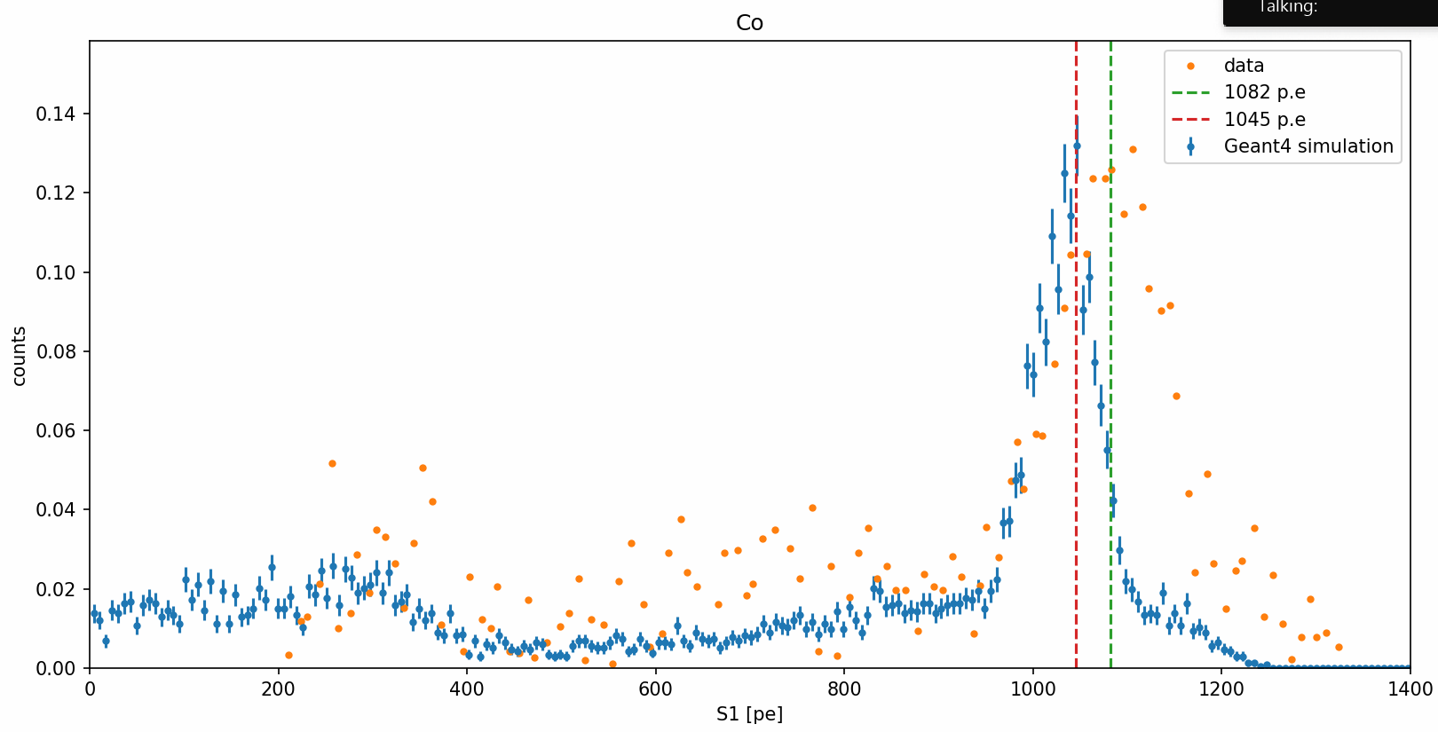
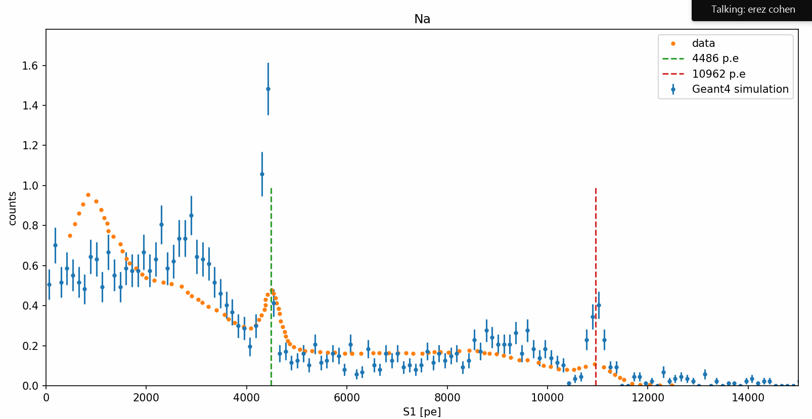
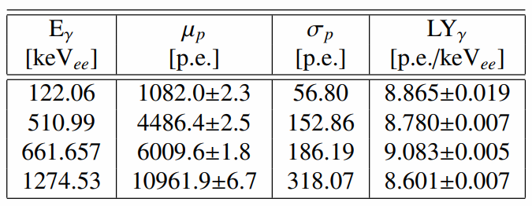
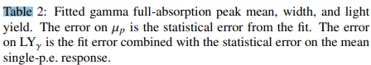
Results
Darkside

Slide 6
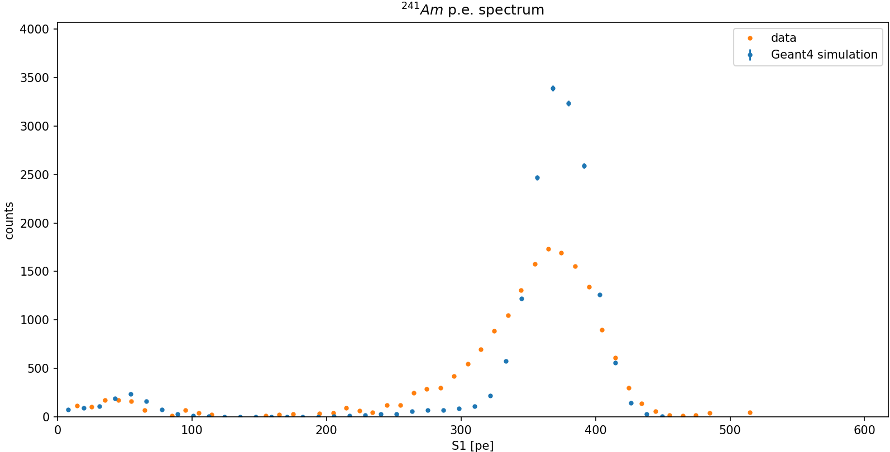
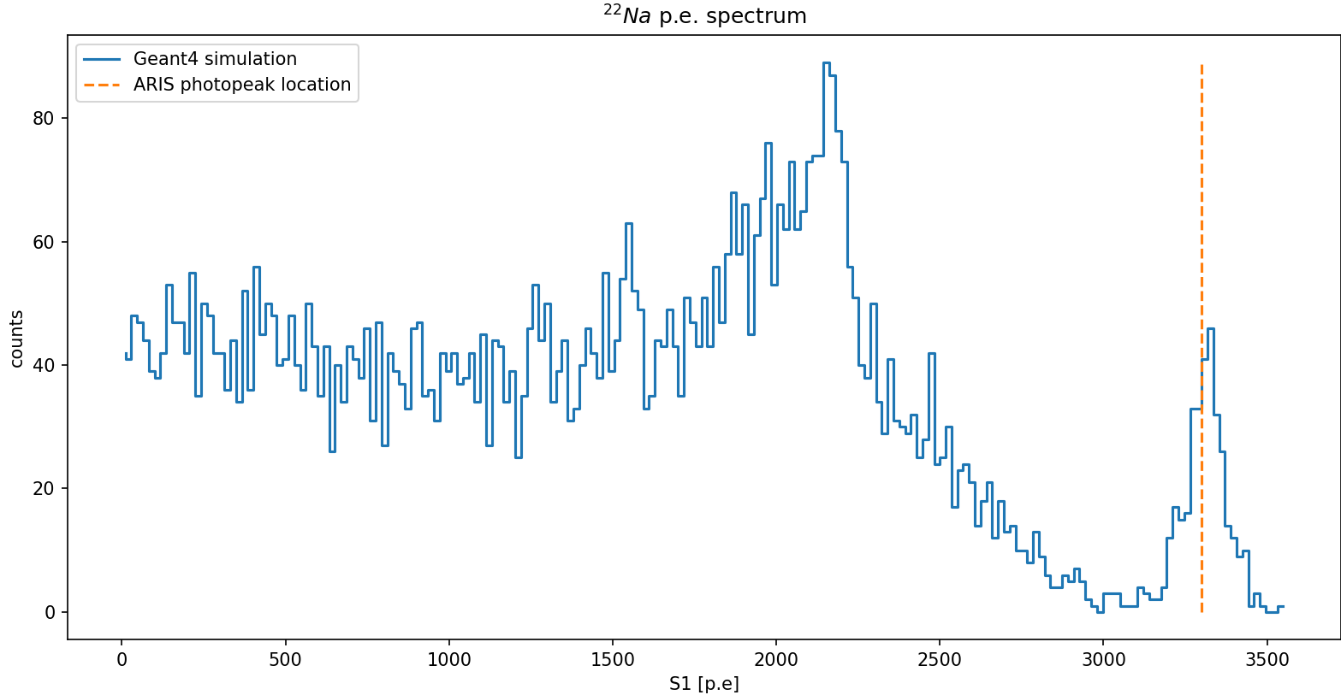

Results
ARIS-$γ$

Slide 7
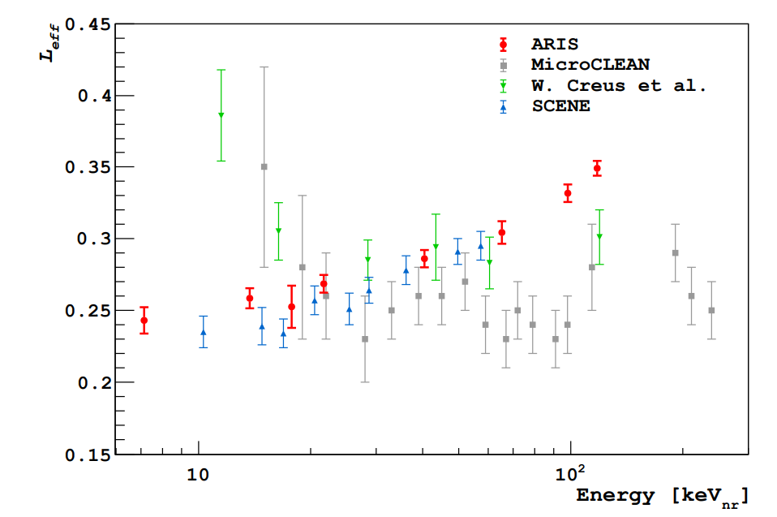
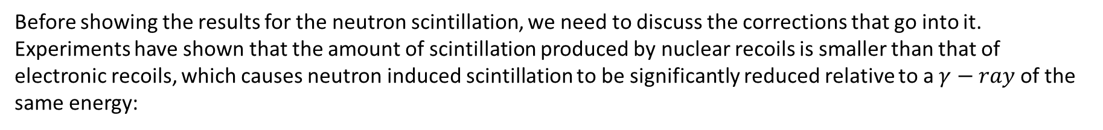

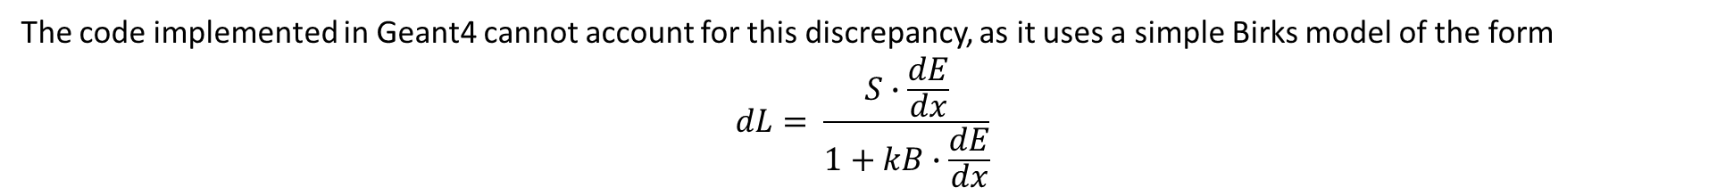
Results
ARIS-$n$
Before showing the results for the neutron scintillation, we need to discuss the corrections that go into it.
Experiments have shown that the amount of scintillation produced by nuclear recoils is smaller than that of electronic recoils, which causes neutron induced scintillation to be significantly reduced relative to a $γ−ray$ of the same energy:
The code implemented in Geant4 cannot account for this discrepancy, as it uses a simple Birks model of the form
$$dL= \frac{S∙\frac{dE}{dx}}{1+kB∙\frac{dE}{dx}}$$

Slide 8
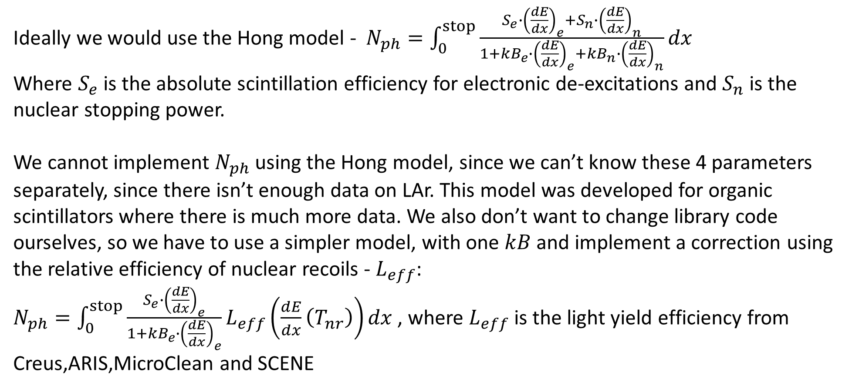
Results
ARIS-$n$
Ideally we would use the Hong model - $N_{ph}=\int_{0}^{stop}{\frac{S_{e}∙{\left(\frac{dE}{dx}\right)}_{e}+S_{n}∙{\left(\frac{dE}{dx}\right)}_{n}}{1+kB_{e}∙{\left(\frac{dE}{dx}\right)}_{e}+kB_{n}∙{\left(\frac{dE}{dx}\right)}_{n}}dx}$
Where $S_{e}$ is the absolute scintillation efficiency for electronic de-excitations and $S_{n}$ is the nuclear stopping power.
We cannot implement $N_{ph}$ using the Hong model, since we can’t know these 4 parameters separately, since there isn’t enough data on LAr. This model was developed for organic scintillators where there is much more data. We also don’t want to change library code ourselves, so we have to use a simpler model, with one $kB$ and implement a correction using the relative efficiency of nuclear recoils - $L_{eff}$:
$N_{ph}=\int_{0}^{stop}{\frac{S_{e}∙{\left(\frac{dE}{dx}\right)}_{e}}{1+kB_{e}∙{\left(\frac{dE}{dx}\right)}_{e}}L_{eff}\left(\frac{dE}{dx}\left(T_{nr}\right)\right)dx}$ , where $L_{eff}$ is the light yield efficiency from Creus,ARIS,MicroClean and SCENE

Slide 9
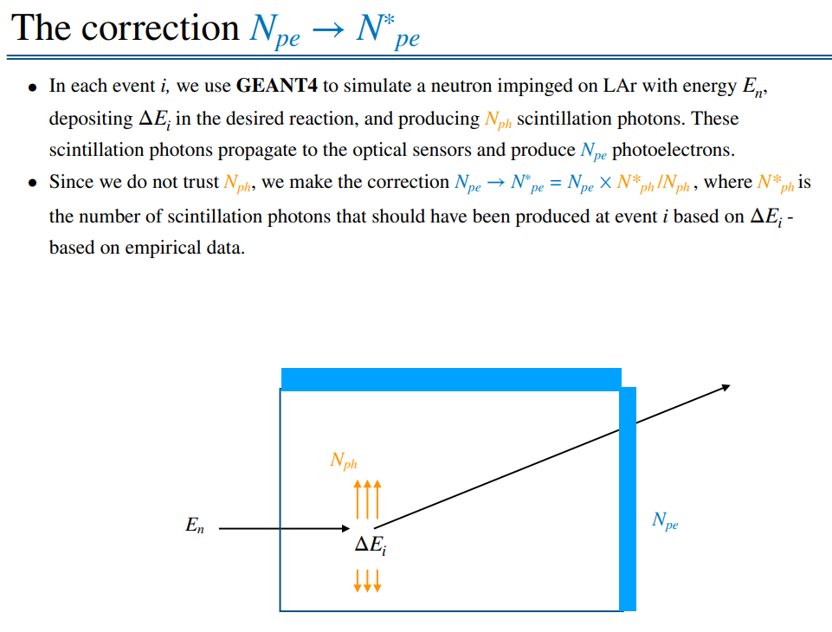
Results
ARIS-$n$

Slide 10
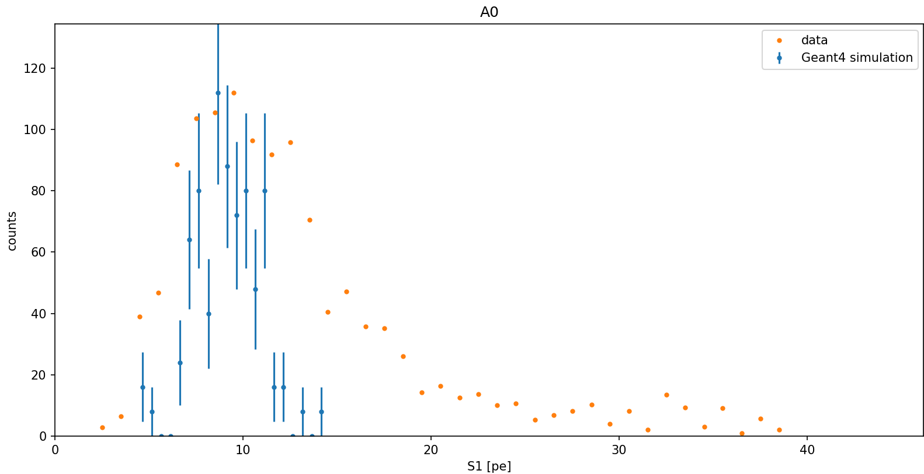
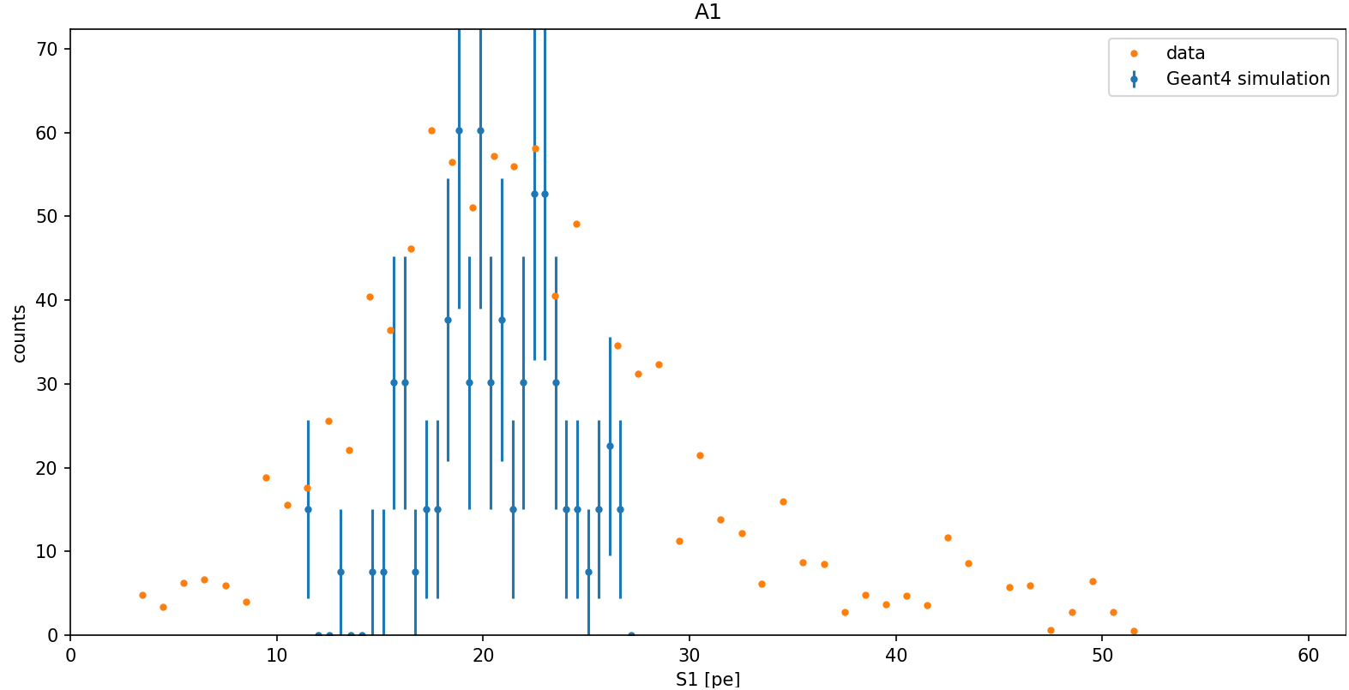
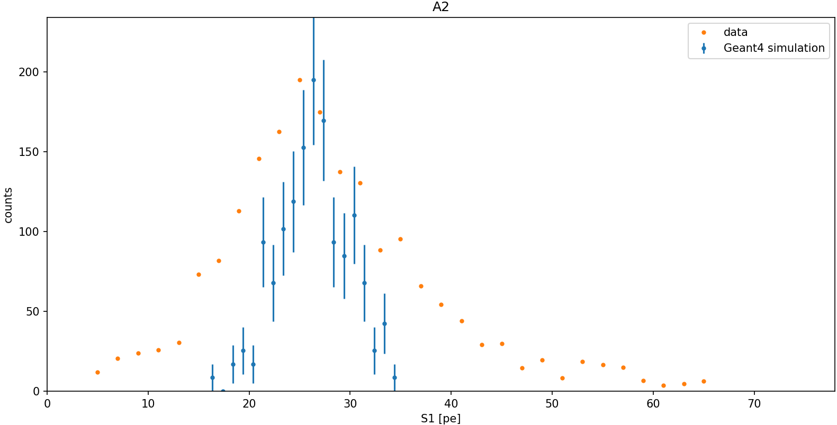
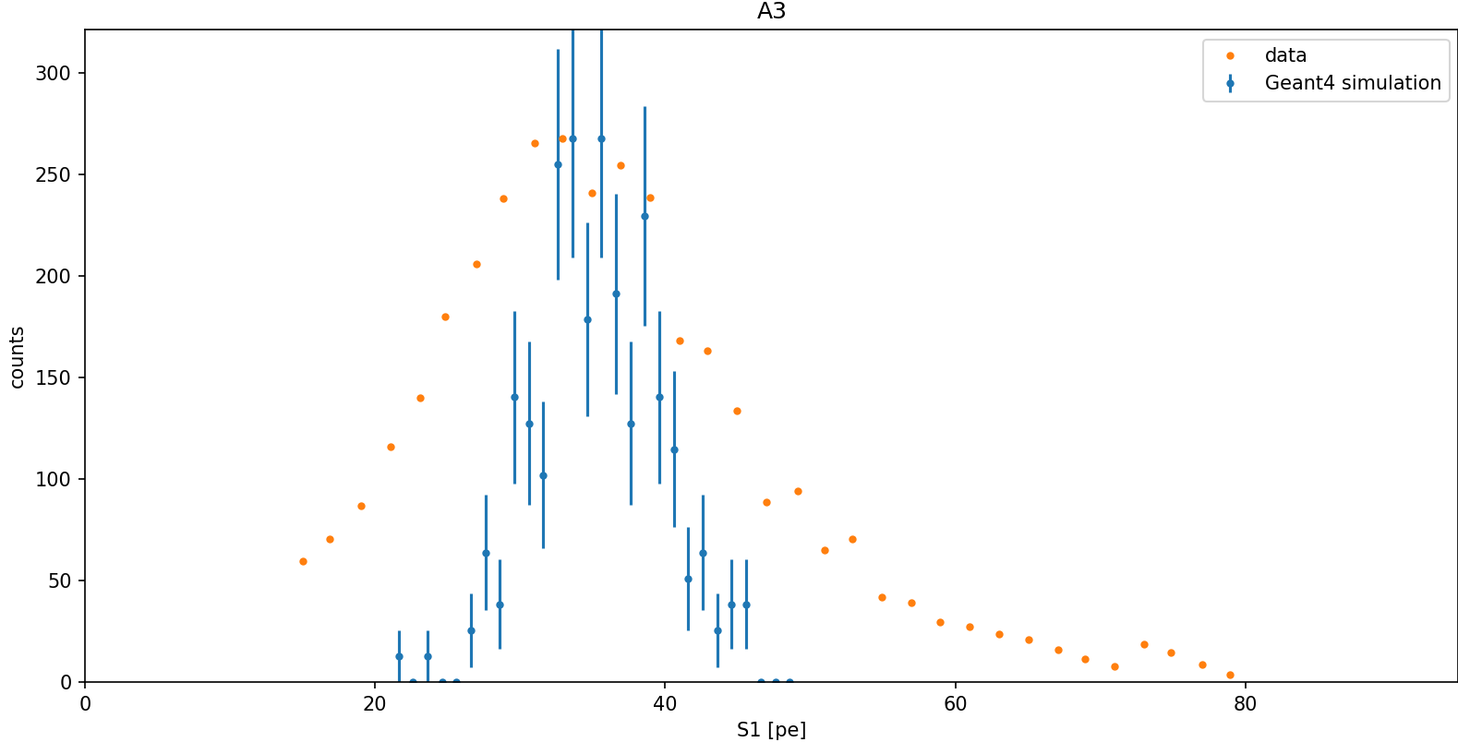
Results
ARIS-$n$

Slide 11
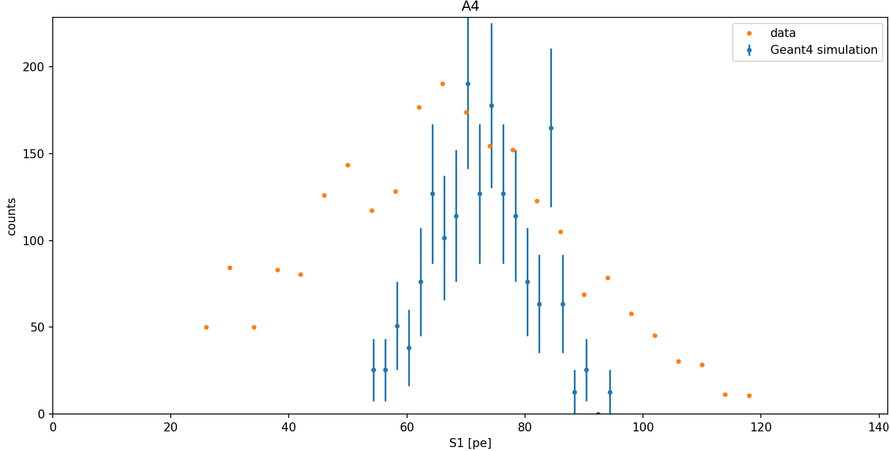
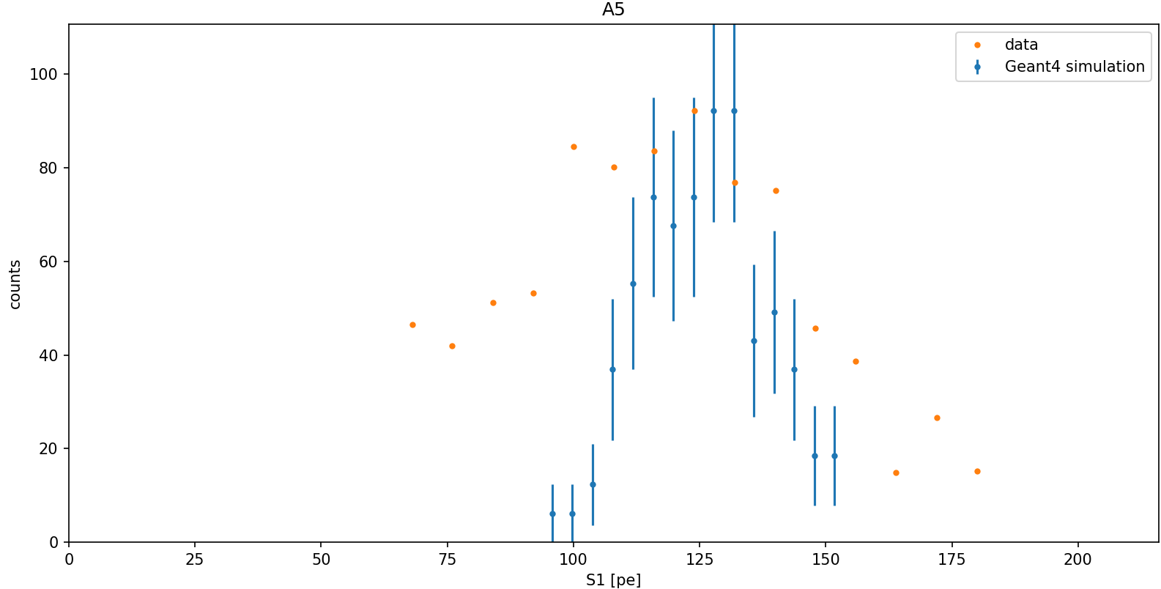
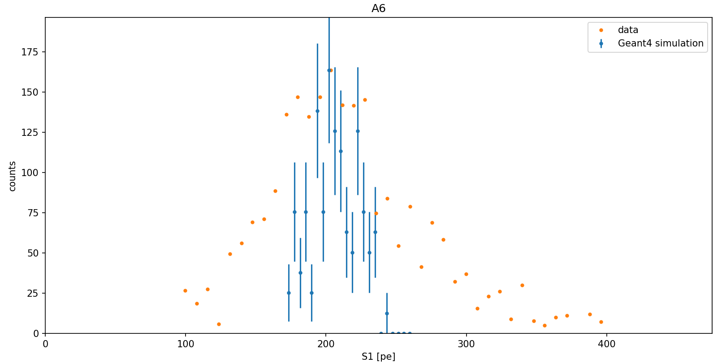
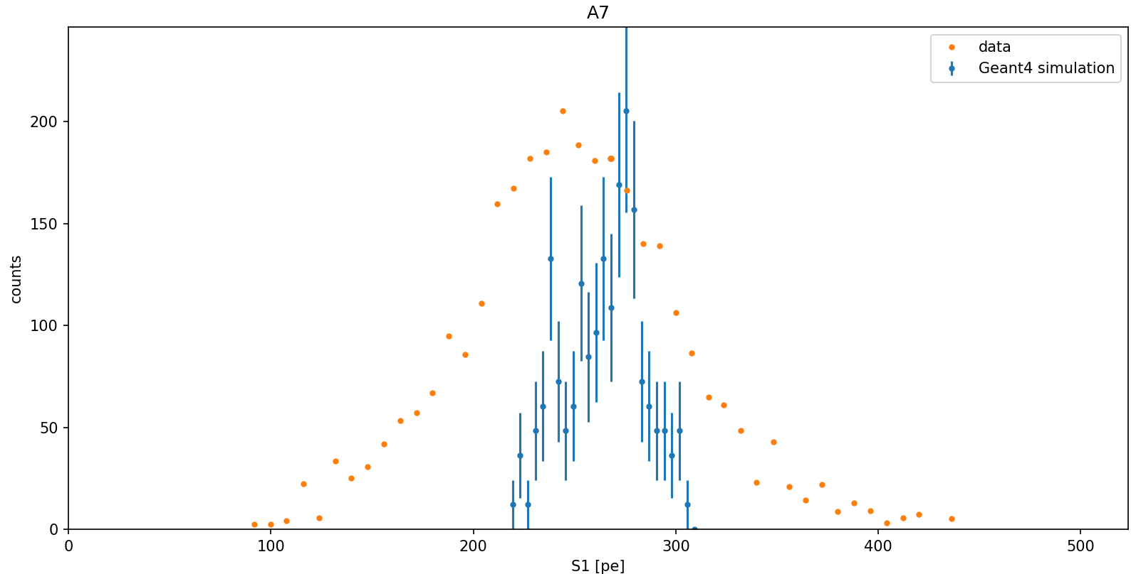
Results
ARIS-$n$

Slide 12
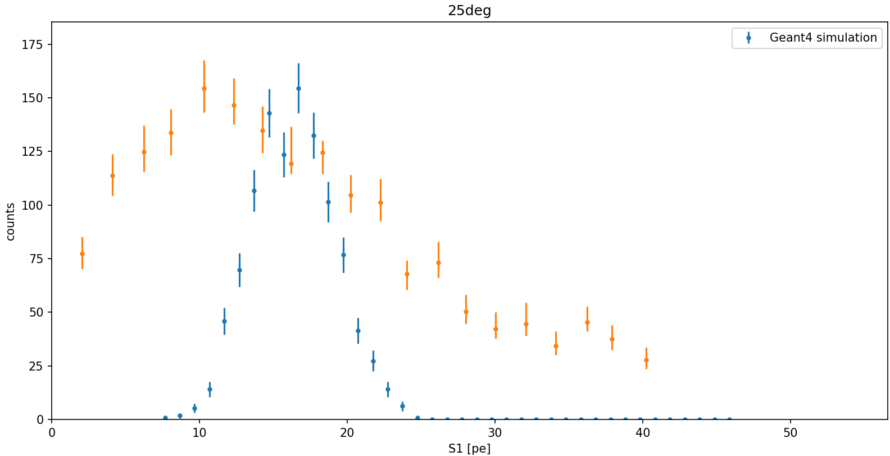
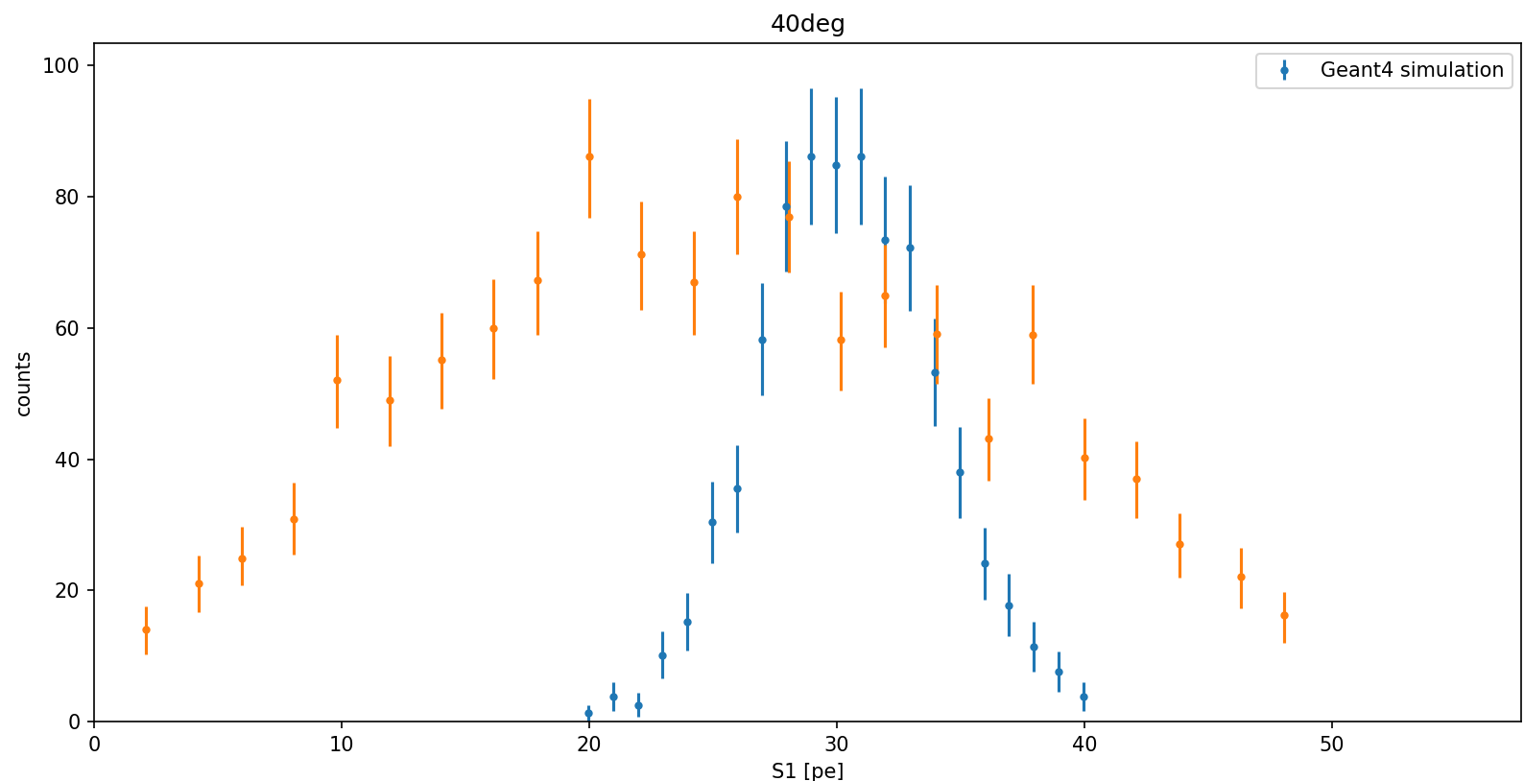
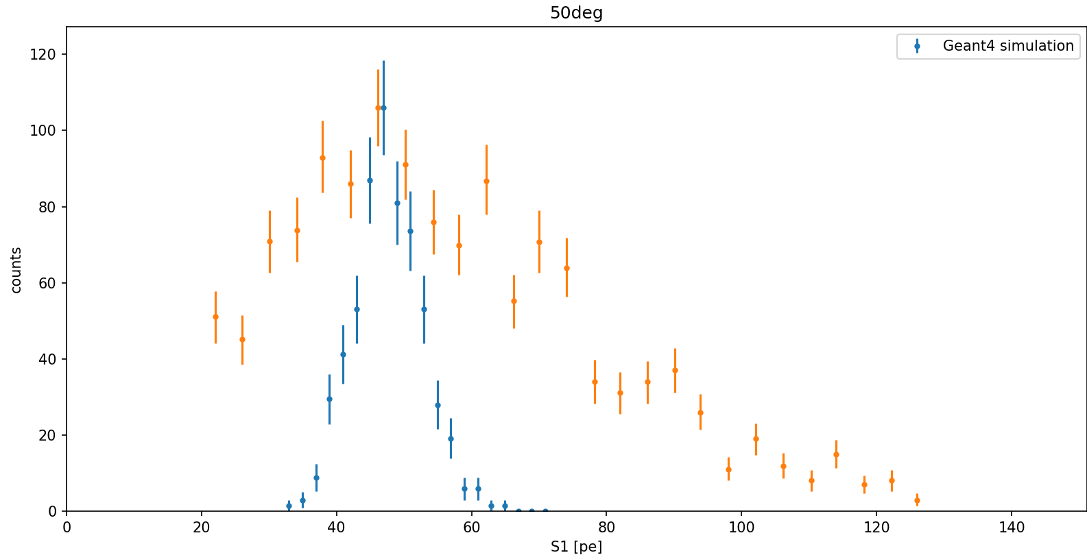
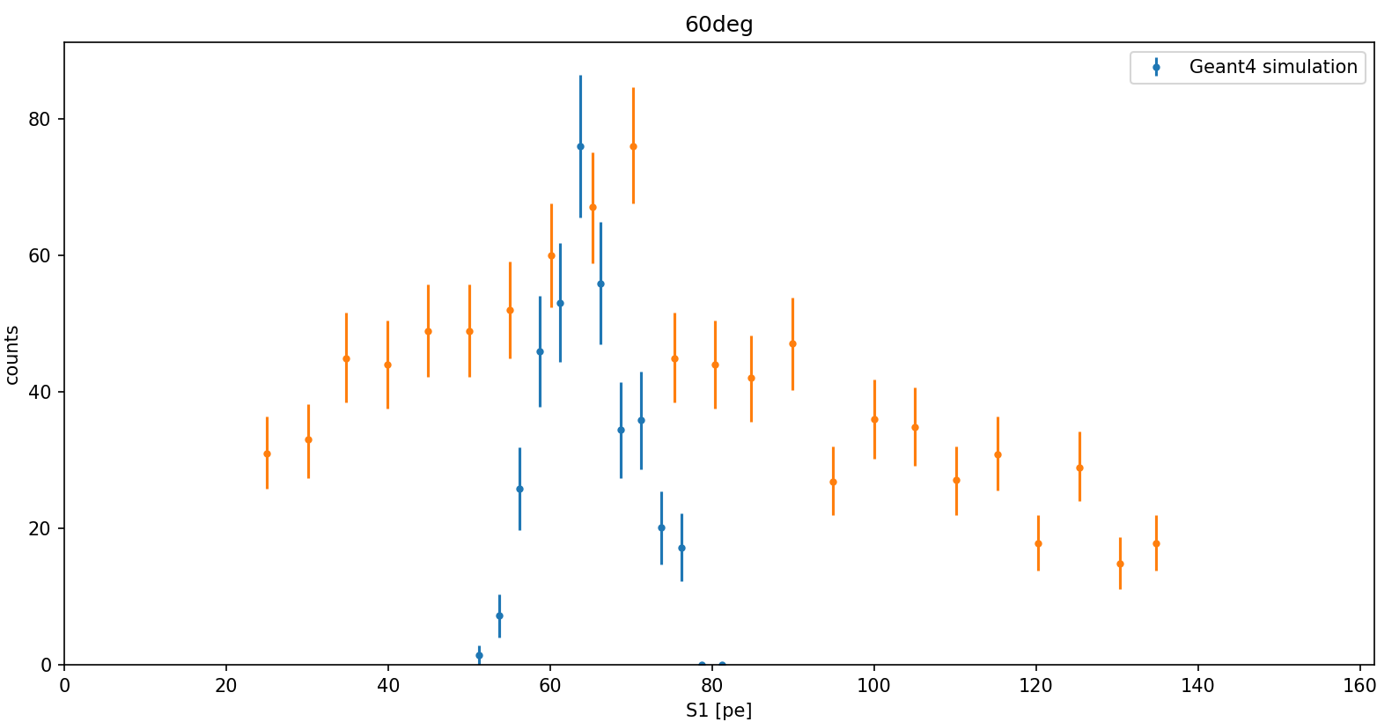
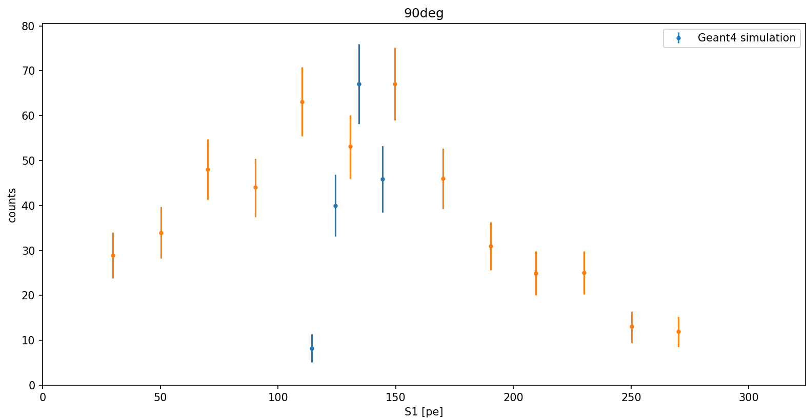
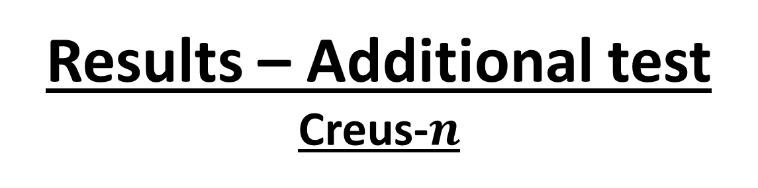
Results – Additional test
Creus-$n$

Slide 13
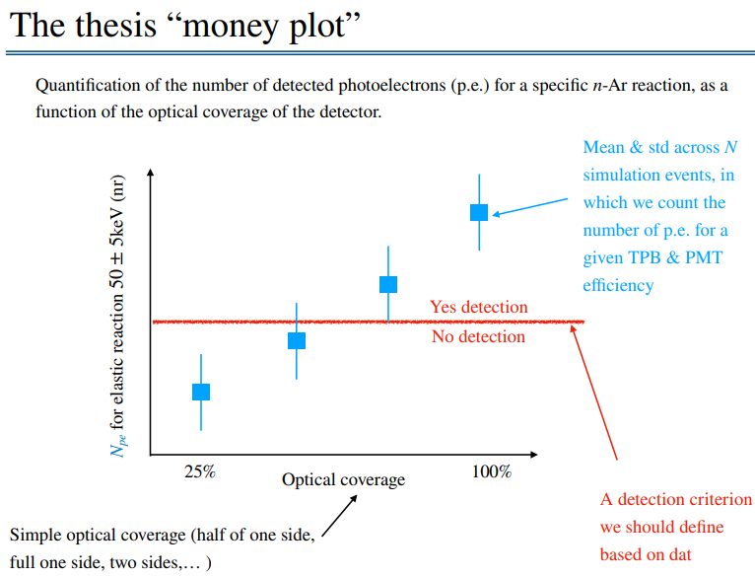
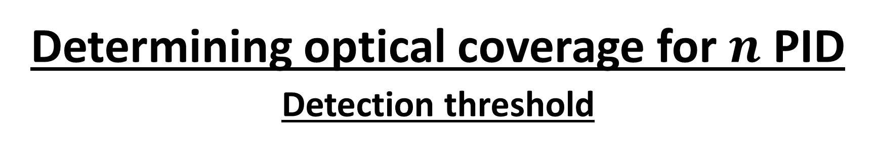
Determining optical coverage for $n$ PID
Detection threshold

Slide 14
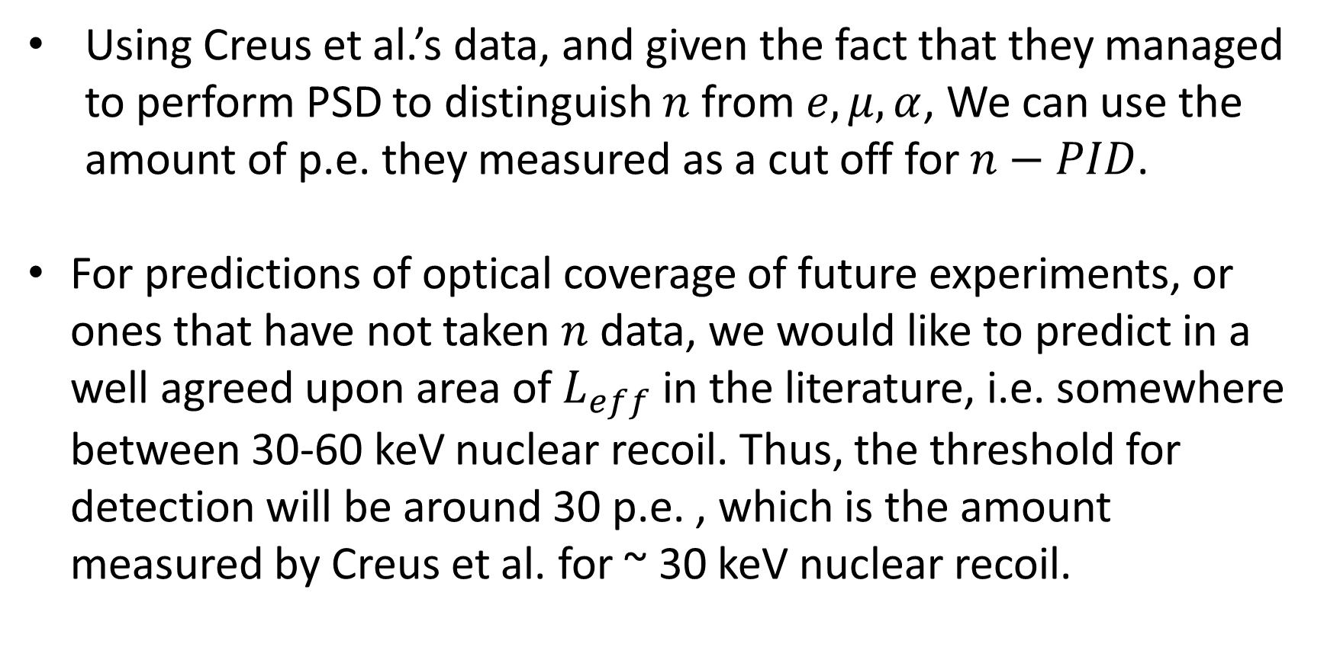
Determining optical coverage for $n$ PID
Detection threshold
Using Creus et al.’s data, and given the fact that they managed to perform PSD to distinguish $n$ from $e,μ,α$, We can use the amount of p.e. they measured as a cut off for $n−PID$.
For predictions of optical coverage of future experiments, or ones that have not taken $n$ data, we would like to predict in a well agreed upon area of $L_{eff}$ in the literature, i.e. somewhere between 30-60 keV nuclear recoil. Thus, the threshold for detection will be around 30 p.e. , which is the amount measured by Creus et al. for ~ 30 keV nuclear recoil.

Slide 15
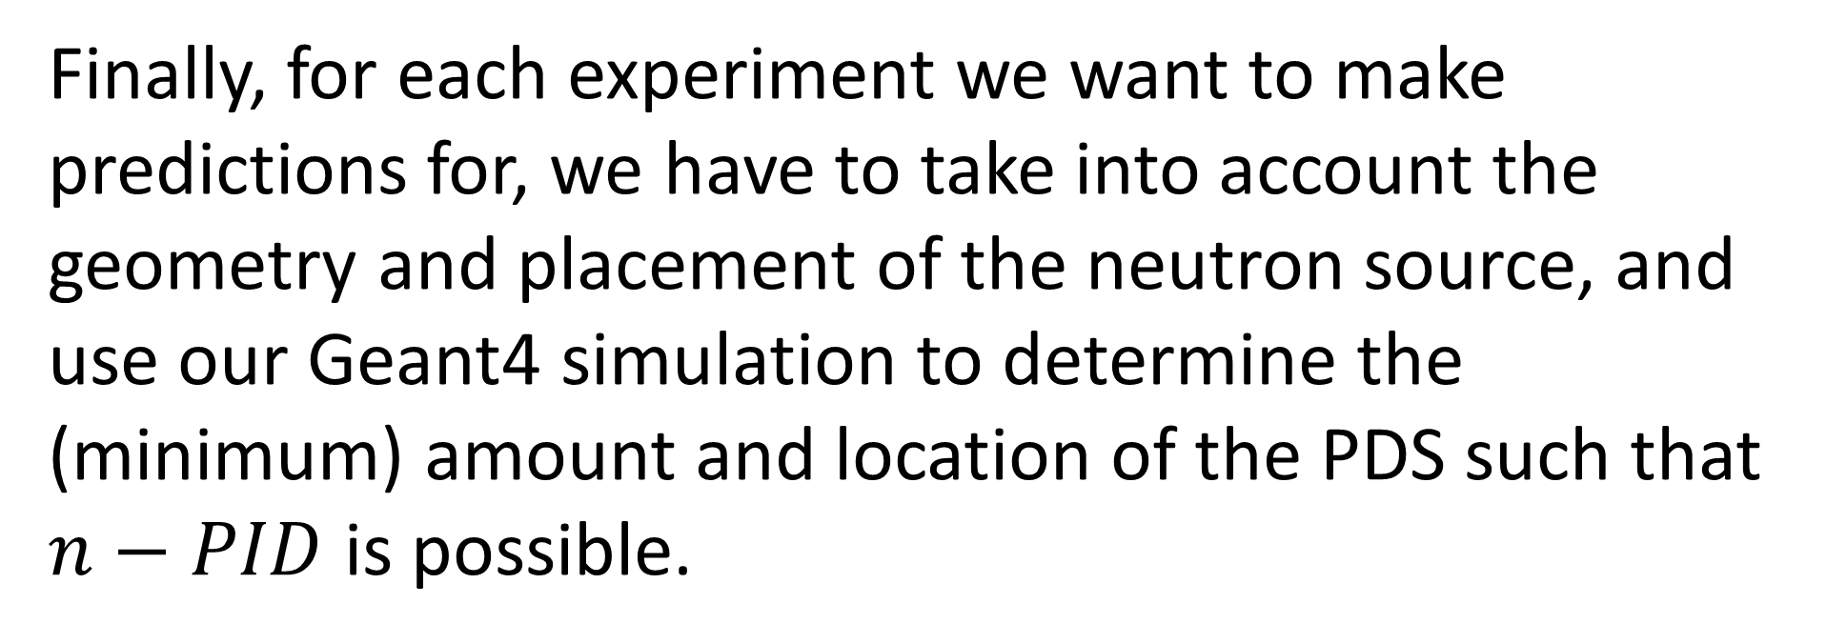
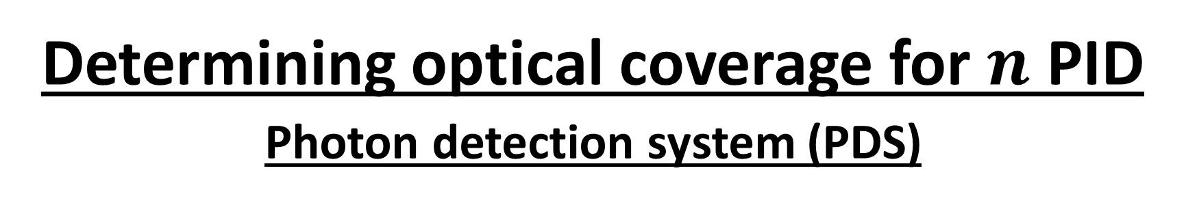
Determining optical coverage for $n$ PID
Photon detection system (PDS)
Finally, for each experiment we want to make predictions for, we have to take into account the geometry and placement of the neutron source, and use our Geant4 simulation to determine the (minimum) amount and location of the PDS such that $n−PID$ is possible.

Slide 16
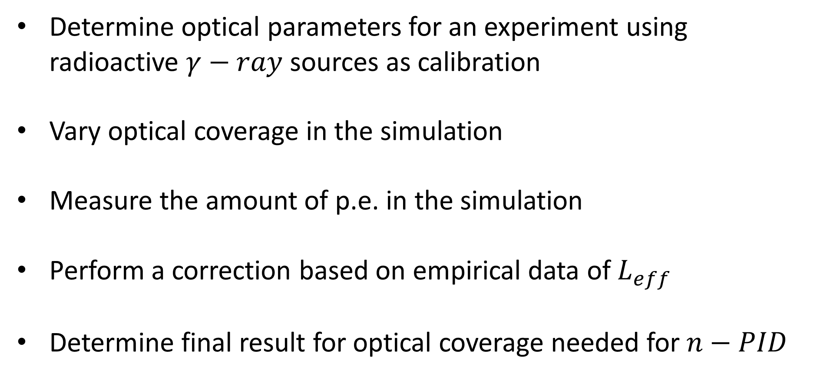
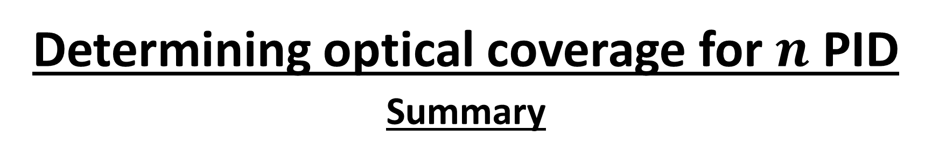
Determining optical coverage for $n$ PID
Summary
Determine optical parameters for an experiment using radioactive $γ−ray$ sources as calibration
Vary optical coverage in the simulation
Measure the amount of p.e. in the simulation
Perform a correction based on empirical data of $L_{eff}$
Determine final result for optical coverage needed for $n−PID$

Slide 17
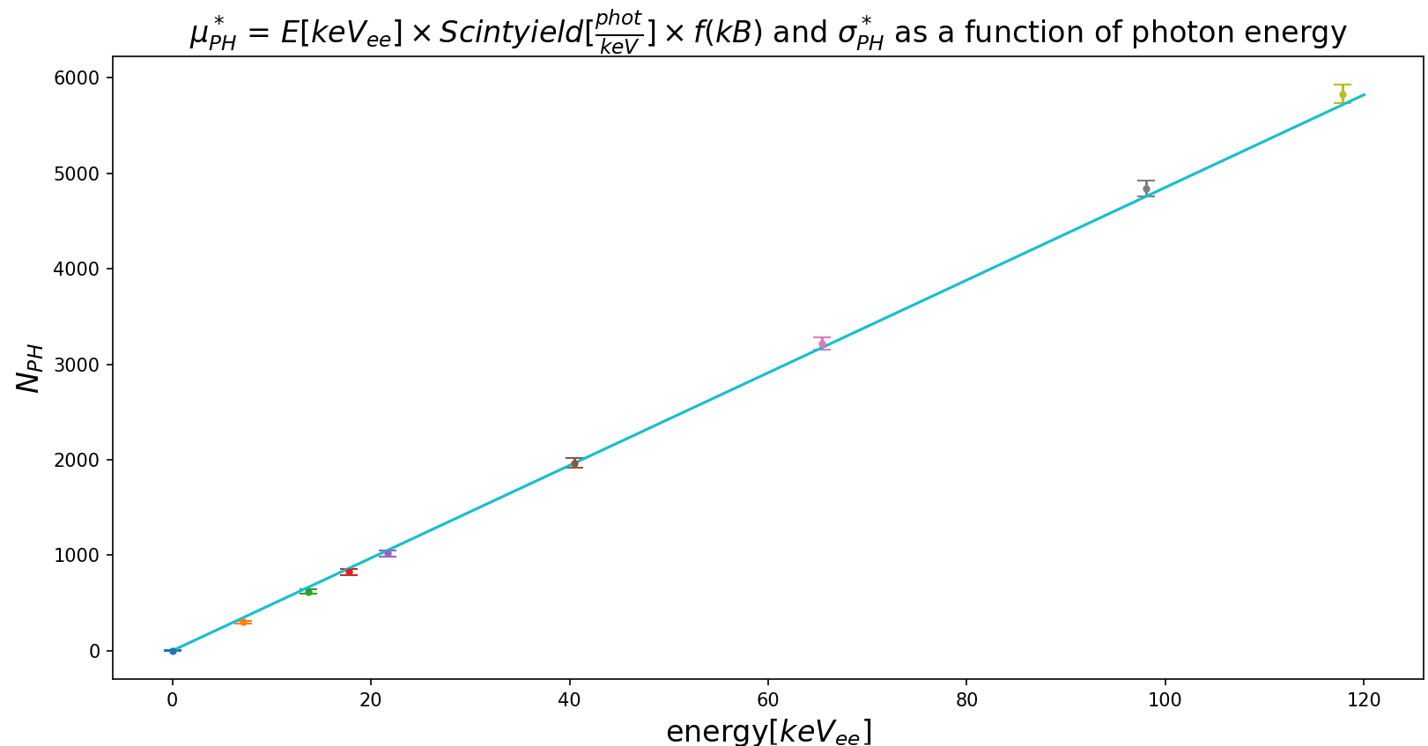

Slide 18
Using L_eff from creus

